Slide 1
Modified TorqueDB
By Akshat Kumar (S.R-19868) and Jeet Ahuja Mukesh kumar(S.R-19703)

Slide 2
Introduction
In IoT applications the data collected from an array of sensors is analysed and decisions are made within few seconds to control the system.
As of late, edge devices are being widely deployed, because they help gather and transmit observations from the sensors, and to enact control decisions. This has resulted in a lot of data, especially time-series data.
Although, TSDBs like InfluxDB are popular choices for hosting such data from sensors and perform temporal queries on the data an these TSDBs reside on the cloud.
since the sensors producing this data and the application consuming this data tend to reside close to the edge devices, sending every query to the central cloud can incur significant latency which is an important factor to consider.
Also, we lose a lot of compute and storage potential in terms of the resources available on the edge and fog devices themselves.

Slide 3
Background and Related Work
This aforementioned issues motivates gives us the motivation to develop an efficient storage and querying system that resides right on the edge and fog devices.
The above discussed motivation is where TorqueDB developed by Dhruv Garg, et al. comes in handy. It leverages ElfStore distributed edge local storage and InfluxDB to offer distributed time-series querying over the edge and fog devices.
We intend to make changes to these leverages by replacing ElfStore with IPFS and use ElasticSearch (ELK Stack) as an indexing mechanism in an effort to improve the efficiency and usability of the database.

Slide 4
Problem definition
The focus of this project is to modify the existing architecture of TorqueDB.
TorqueDB uses ElfStore to manage the input data accumulated in blocks hosted by Edge devices. ElfStore stores data in blocks, where each block contains rows of time-series data, typically from one or more sensors and for a specific timing range.
Now in our project we are replacing the ElfStore with IPFS (Interplanetary File System). IPFS service will handle the replication, block placement of the input data.
But to maintain indexes on the metadata for blocks, we need to implement ElasticSearch. ElasticSearch will handle the indexing and querying on the metadata for blocks.

Slide 5
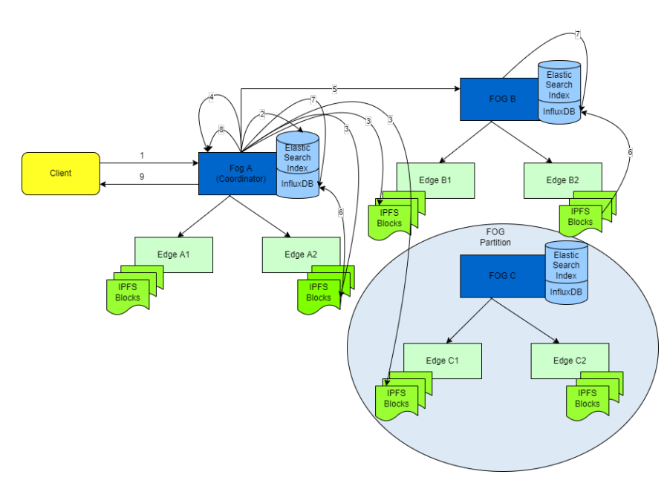
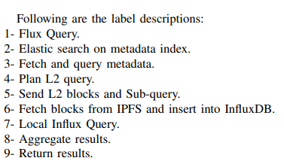
Solution approach
Proposed architecture:

Slide 6
About the new technologies used:
IPFS
The Interplanetary File System is a protocol and peer-to-peer network for storing and sharing data in a distributed file system.
A content addressed storage is employed by IPFS. i.e., for accessing data through IPFS, contents of data is being, instead of location-based addressing.
The mechanism is like BitTorrent. Instead of having a centrally located server, IPFS is built around a decentralized system of multiple host-operator nodes where each node holds a part of the total data, resulting in a resilient system of file storage and sharing.
Any node in the network can serve the required file using the content as an address, and other peers can find and request that content from any host having that content using Distributed Hash Table.

Slide 7
About the new technologies used: (Contd.)
ElasticSearch
Elasticsearch is distributed, open-source search and analytics engine built using Apache Lucene and developed in Java.
Elasticsearch allows us to store, search and analyse huge volumes of data quickly and efficiently by searching the text directly.
In simpler terms, we can think of Elasticsearch as a server that receives JSON requests and gives back JSON data, all of it being leveraged with extensive REST APIs.
It uses inverted index. i.e., a hashmap-like data structure that directs from a word to a document. Elastic search distributes the tasks of searching and indexing across all the nodes in the cluster.
In our case ElasticSearch indexes based on the metadata. And when a client queries, the searching is done based on the meta-data. First step will be to elastic search the index using the meta-data requested.

Slide 8
Solution Approach(Contd)
We shall be solving the above stated problem in the following stages:
Study IPFS.
Study Elastic Search.
Find a way to package metadata into a common file.
Figure out a configuration to index these metadata using elastic-search and store as key-value pairs.
Query planning in terms of indexes produced by Elastic-Search. (Pending)
Integrate the ES+IPFS into torqueDB after decoupling ElfStore. (Pending)

Slide 9
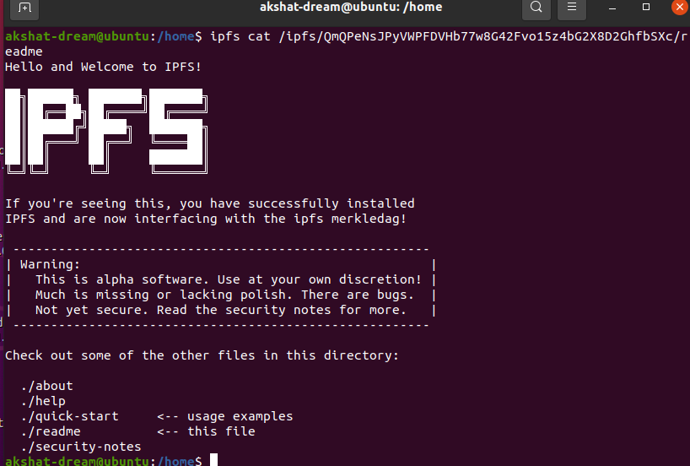
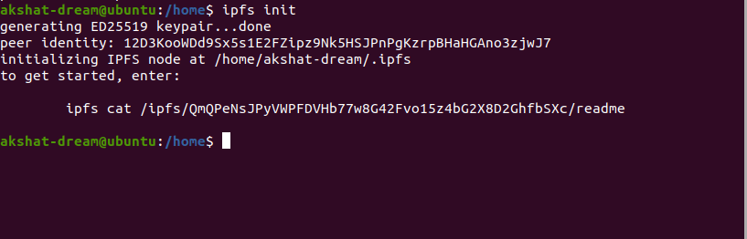
Experiments
Initializing IPFS using init call and adding key to authenticate node on IPFS.

Slide 10
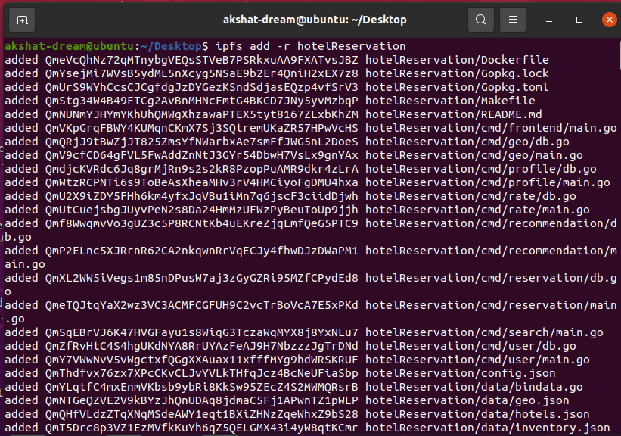
Experiments(Contd.)
Adding files recursively to IPFS using default pinning configurations.

Slide 11
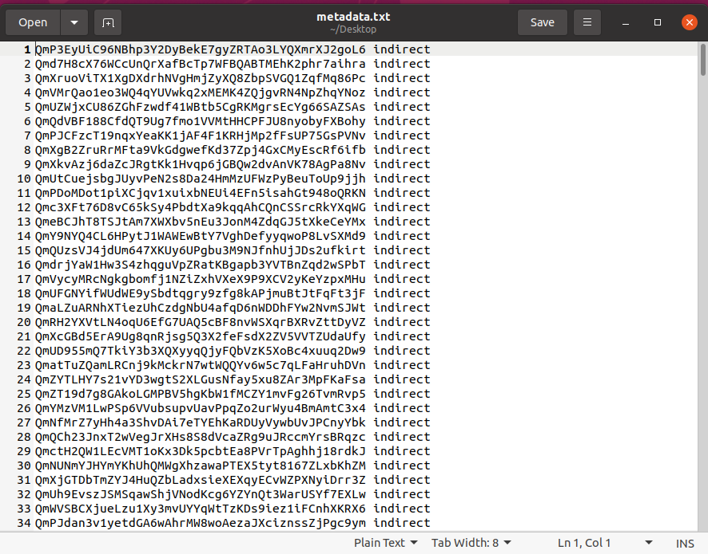
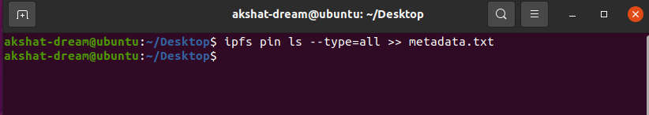
Experiments(Contd.)
Creating a metadata file of the list of files added in order to insert into elastic search.

Slide 12
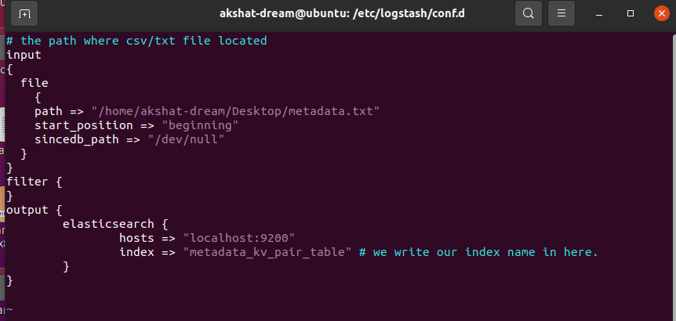
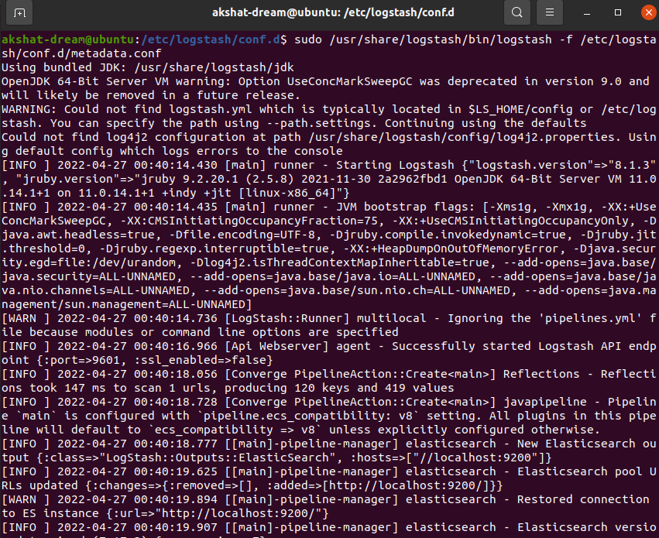
Experiments(Contd.)
Configure logstash using the conf file in-order to push metadata into the elastic search server in order to index it in for of key value pair.

Slide 13
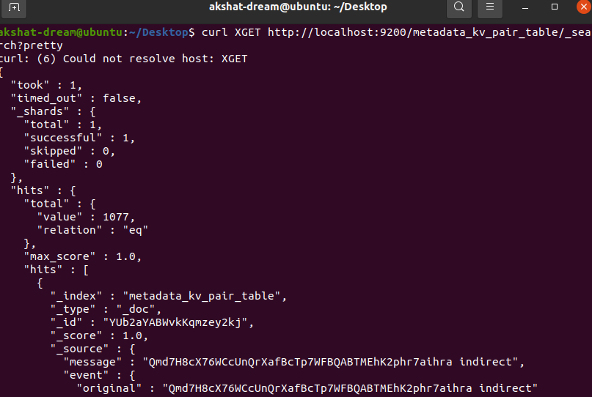
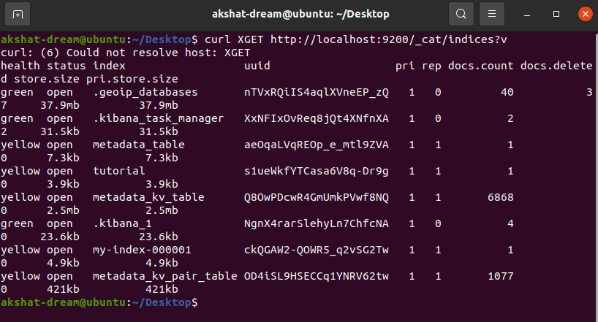
Experiments(Contd.)
Verify if files have been inserted and indexed.

Slide 14
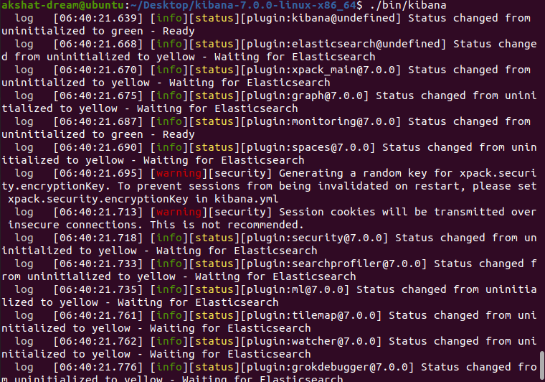
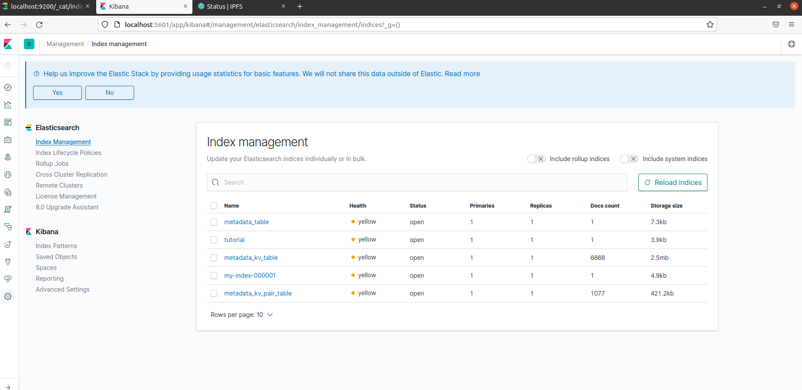
Experiments(Contd.)
Launch kibana via webui or cli inorder to modify or check indexing pattern if needed.

Slide 15
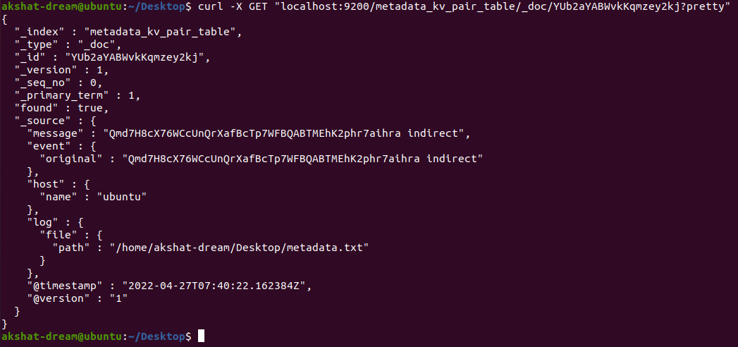
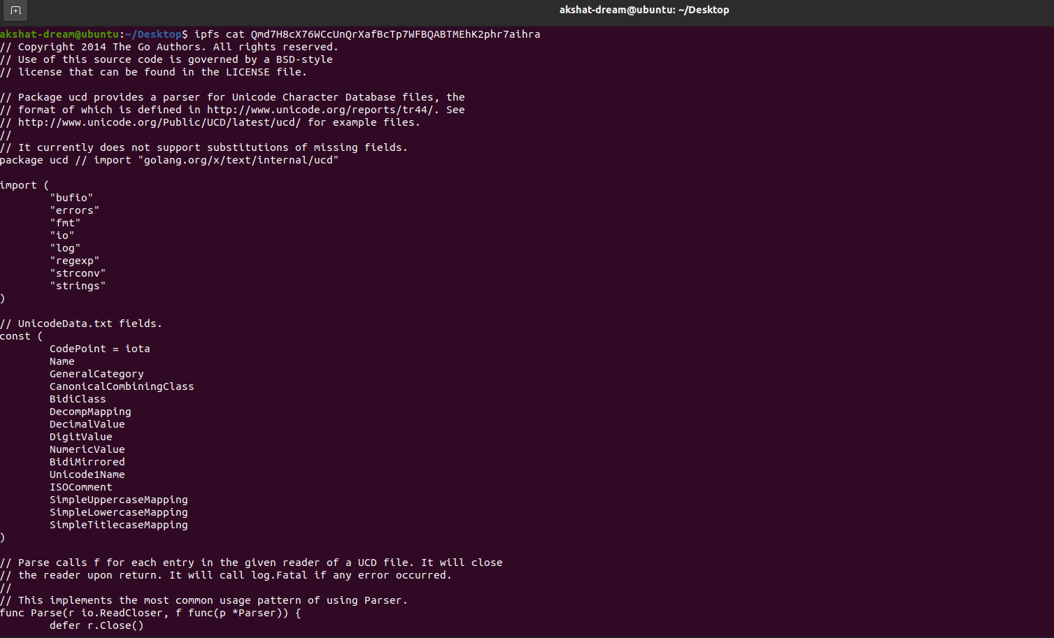
Experiments(Contd.)
We can now retrieve the metadata values of a file using the indexes of ElasticSearch via API call. The obtained Hash for the index can be used to retrieve files from IPFS Server using IPFS API call.

Slide 16
Future work
Now that we have the basics down of how to integrate Elasticsearch with IPFS, we can now make necessary changes in the logstash bul push config file.
The first change is to make id of Elasticsearch as the metadata of the file itself i.e. instead of indexing the metadata, we will index with the metadata.
Append the value field to have “ipfs get” in front of the hash key and make it auto execute.
This means that the user can search files in Elastic search using file metadata and in return, the search will initiate a retrieve file with that metadata and get the required files ready for further work in InfluxDB.

Slide 17
Conclusion
IPFS comes across as a strong peer to peer based distributed file storage system with huge potential in Edge computing.
Elastic search provides a relatively easy mechanism for indexing files with support from Logstash in order to push the files into the server and Kibana provides a good playing ground to visualize and play around with indexing.
We shall hopefully be able to integrate this combination into TorqueDB and compare results with existing ElfStore mechanism in near future.

